Slide 1

Science and research at FHS UK Basic information about doctoral studies
September 25, 2025

Slide 2

FHS UK as a scientific and research organization
The university's activities: education, science and research, the "third role" of social responsibility
At the Faculty of Humanities, science is integrated into all levels of study.
In the PhD program, science and research are of fundamental importance:
the program prepares students for scientific and research careers;
Doctoral candidates conduct independent research under the guidance of a supervisor and other experts;
the doctoral dissertation must include original scientific results;
To successfully complete the program, students are required to publish sufficient research findings.

Slide 3
Where can I find information about support for doctoral students' scientific and creative activities at the Faculty of Humanities, Charles University?

Slide 4
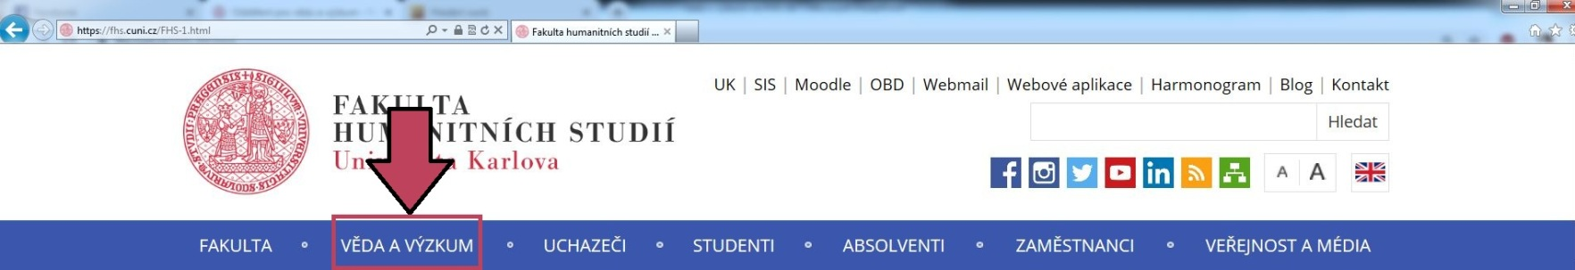
I. Research Administration Office
veda@fhs.cuni.cz Rooms 1.23 and 1.24 https://veda.fhs.cuni.cz/FHSVEDA-1.html | Prof. Dr. phil. Pavel Himl Vice-Dean for Science and Research pavel.himl@fhs.cuni.cz | Ing. Jan Bělonožník Head of Department jan.belonoznik@fhs.cuni.cz COOPERATIO | Mgr. Renata Wilflingová renata.wilflingova@fhs.cuni.cz COOPERATIO, RUV, KEV
Mgr. Eva Benešová eva.benesova@fhs.cuni.cz GA ČR, GA UK, UNCE, PRIMUS | Mgr. Martin Mišúr, Ph.D. martin.misur@fhs.cuni.cz Science evaluation, publishing, data steward | Tomáš Renner, Ph.D. Tomas.renner@fhs.cuni.cz European and international projects; Erasmus+, | Mgr. Kateřina Kovaříková Katerina.kovarikova@fhs.cuni.cz Publishing

Slide 5
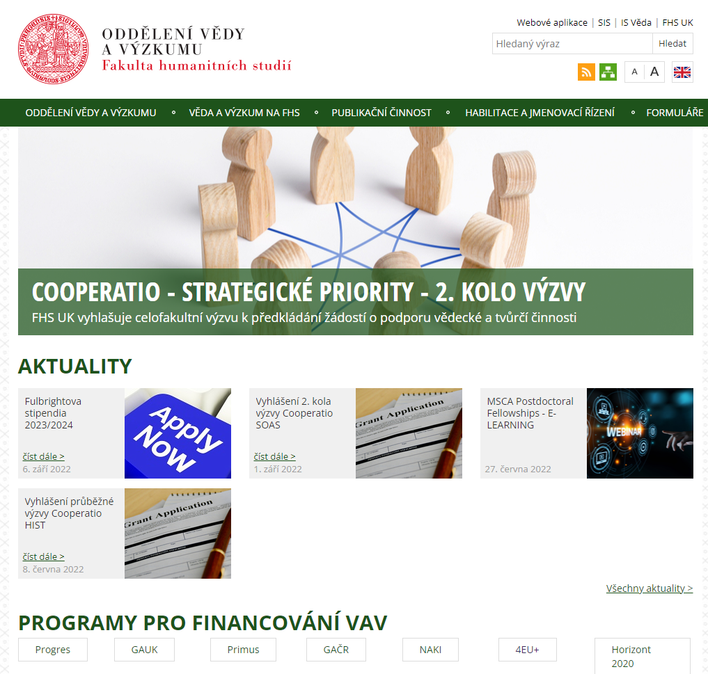
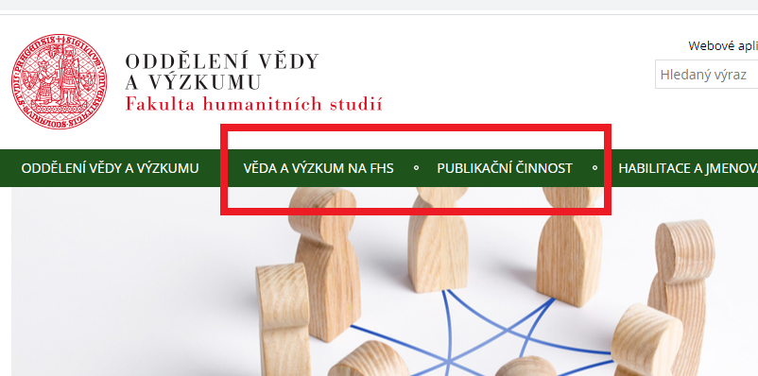
II. Our website
veda.fhs.cuni.cz/FHSVEDA-1.html

Slide 6
Financial support sources for research and PhD students at the Faculty of Humanities, Charles University

Slide 7

Subsidy programs and grants
Special-purpose funding:
grants for specific projects, for PhD =
Grant Agency of Charles University (GAUK)
Institutional funding:
Cooperatio programs

Slide 8
GRANTS Charles University Grant Agency (GA UK)
Annual competition for student research projects
Relevant documents: Rector's Measure No. 11/2023, 32/2025
Open to students enrolled in master's and doctoral programs. (Note: Only students within the standard study period are eligible to apply!)
Each research team must include a principal investigator
Project duration: 1 to 3 years; maximum funding of CZK 300,000 per year (for salaries, scholarships, accommodation costs, services, and materials).
Project output: only original (peer-reviewed) publications will be accepted; for submissions in Section C (Medical Sciences), publication in an impact factor journal is mandatory;
For research involving clinical trials or animals, a statement from the Committee for Ethical Research is required!

Slide 9
Charles University Grant Agency (GA UK)
New project proposals can be submitted from October 1, 2025, to October 29, 2025 via the web application https://is.cuni.cz/webapps/?lang=cs
A seminar for applicants will be held on Thursday, October 2, 2025, from 4:00 p.m. to 5:30 p.m. in seminar room 0.31 of the FHS UK building.
Detailed information: https://veda.fhs.cuni.cz/FHSVEDA-5.html?news=26937&amp;locale=cz
Contact person: Mgr. Eva Benešová (eva.benesova@fhs.cuni.cz)

Slide 10
INSTITUTIONAL SUPPORT: COOPERATIO Programs
The Ministry of Education, Youth and Sports grant programs awarded to Charles University to support academic staff and doctoral students.
This is not a grant program; it provides partial, one-time, or extraordinary support for scientific and creative activities.
Doctoral students can use this subsidy fund:
In justified cases, funding may be provided to support the implementation of dissertation research, such as the purchase of specific equipment or materials.
In justified cases, also as support for trips to conferences
It is primarily used to support the preparation of publications, including proofreading, support for open publishing, and payment for related services, as well as for conference presentations.

Slide 11
COOPERATIO Program
Classification of Ph.D. students within the Cooperatio program:
PhD students cannot be classified under any scientific field, but only under accredited study programs.
Classification takes place after enrollment, based on an agreement among the doctoral student, their supervisor, and the SP guarantor.
PhD students are typically enrolled in one field of study. If a doctoral student's research clearly spans two fields, they may also be enrolled in the second field.
When assigning doctoral students to scientific fields, we consider their scientific activity as reported in the OBD, specifically the field in which they most frequently present their results. Additionally, we take into account the topic of their dissertation and the expertise of their supervisor.

Slide 12
COOPERATIO Program
Link between Cooperatio scientific disciplines/fields and Ph.D. study programs:
STUDY PROGRAM | SCIENTIFIC DISCIPLINES | COOPERATIO FIELDS
Applied Ethics | o Philosophy and Ethics o Social Work | PHIL + SOAS
Applied Ethics
Historical Sociology | o History o History and Philosophy of Science o Sociology | HIST + SOAS
Historical Sociology
German and French Philosophy | o Philosophy and Ethics | PHIL
German and French Philosophy
Deutsche und französische Philosophie
General Anthropology | o Social and Cultural Anthropology o Ethnology o History o History and Philosophy of Science o Philosophy and Ethics o General and Developmental Psychology o Health and Clinical Psychology | SCAN + HIST + PHIL + HEAS + PSYC
General Anthropology
Semiotics and Philosophy of Communication | o Philosophy and Ethics o Media and Communication Studies | PHIL + MCOM
Semiotics and Philosophy of Communication
Social Ecology | o Public and Social Policy o Sociology | SOAS
Social Ecology
Contemporary European Cultural History | o History o History and Philosophy of Science | HIST
European Cultural History
Contemporary European Cultural History
Longevity Studies | o Health and Clinical Psychology o Social Work o Sociology | HEAS
Longevity Studies
Civil Sector Studies | o Sociology o Public and Social Policy | SOAS

Slide 13
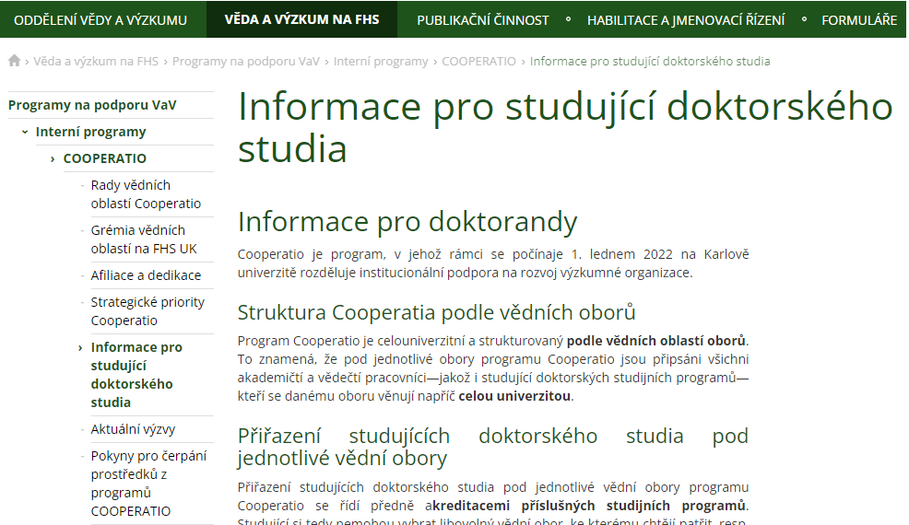
INSTITUTIONAL SUPPORT: COOPERATIO Programs
Cooperatio connects you with academic staff at the Faculty of Humanities, Charles University, who are dedicated to developing the academic discipline in which you are studying. Each doctoral student belongs to a specific academic area of the Cooperatio program:
veda.fhs.cuni.cz/FHSVEDA-204.html

Slide 14
Publications

Slide 15
Publications
Scholarly papers are the key indicator of scientific performance, the basis for personal evaluation, and thus, for career advancement and title awards.
articles in journals
book chapters
monographs
Scientific funding largely relies on the reporting of publication activities, which is why an individual's research performance also benefits their faculty.
For details on types of publications and obligations see https://veda.fhs.cuni.cz/FHSVEDA-78.html

Slide 16
Personal identifiers
To accurately attribute each publication to its correct author, it is essential to create and verify personal identifiers, also known as academic identities.
ORCID iD
ResearcherID
Scopus ID
You need to create an ORCID ID within one month of registration and confirm it by emailing martin.misur@fhs.cuni.cz. Your ResearcherID and Scopus ID will be created automatically.
Detailed information on identifiers and obligations: https://veda.fhs.cuni.cz/FHSVEDA-82.html
Step-by-step guide to creating an ORCID ID: https://openscience.cuni.cz/OSCI-297.html

Slide 17
Publication records
Publications with a personal identifier must be recorded in the database of publications and creative activities, known as OBD
affiliation, i.e., faculty membership
Dedication, i.e., source of funding
Affiliations and dedications must be clearly stated in publications, following specific formats based on the type of institutional or grant support.
Access to the OBD database: https://cas.cuni.cz/cas/login?service=https%3a%2f%2fis.cuni.cz%2fveda%2fportal%2f
Detailed information on entering records into the OBD: https://veda.fhs.cuni.cz/FHSVEDA-78-version1-obd_eng.pdf
Overview of affiliation and dedication texts: https://veda.fhs.cuni.cz/FHSVEDA-270.html

Slide 18
Open publishing
An increasing number of prestigious journals are published in open access mode, which has its own specific rules
Green OA is free of charge
Gold OA is paid
Diamond OA is free
Open Access (OA) fees, which can reach thousands of dollars or euros, are typically considered eligible costs in project budgets. Therefore, they should be included in the draft budget of the project proposal. Notably, significant discounts and tokens are offered based on what are known as transformation agreements.
Details on open access rules: https://veda.fhs.cuni.cz/FHSVEDA-114.html
Overview of currently available discounts and tokens: https://openscience.cuni.cz/OSCI-244.html

Slide 19
Predatory publishing
A significant number of predatory journals are published in open access mode to parasitize on publication fees
Predators do not follow established standards of scientific ethics
Publishing in these journals can cause reputational issues
Predatory publications cannot be registered in OBD
Due to the seriousness of the issue, it is highly recommended that you reach out to your faculty contacts if you have any uncertainties. Above all, carefully consider your publication choices.
Recommendations on how to identify a predator: https://openscience.cuni.cz/OSCI-37.html
Be cautious, there are also predatory conferences: https://openscience.cuni.cz/OSCI-79.html

Slide 20
Publishing activities at FHS UK
It is possible to publish in prestigious open access (OA) journals associated with the Faculty of Humanities or to submit a proposal to the Faculty Publishing Committee for publishing a monograph.
Urban People
History – Theory – Criticism
Alexandra Brocková: The Non-Local Place of Man. Giovanni Pico della Mirandola, Blaise Pascal, Søren Kierkegaard, Max Picard, Prague: FHS UK 2024
Both journals are published under the Diamond OA model, which means they have no costs for authors to publish and accept articles written in English. The FHS UK Editorial Board convenes twice a year.
For details on the dates of the FHS UK Editorial Board meetings: https://veda.fhs.cuni.cz/FHSVEDA-279.html
People of the City: https://ojs.cuni.cz/lidemesta

Slide 21
Ethical aspects of conducting research and creative activities at the Faculty of Humanities, Charles University

Slide 22
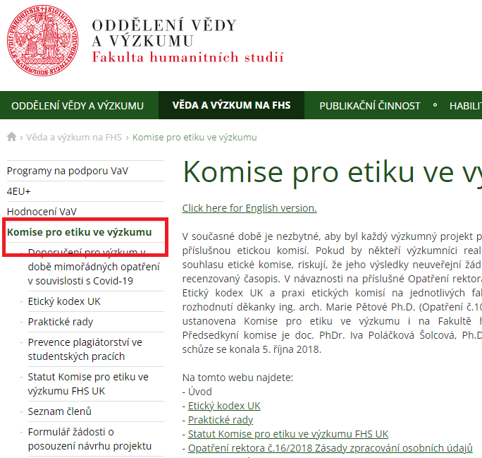
Ethics in Research at Charles University
Committee for Ethical Researchat the Faculty of Humanities, Charles University (not to be confused with the Ethics Committee!)
Ethical aspects of research (human participants, personal data protection, informed consent, sensitive approach to vulnerable groups, etc.)
Consultations, opinions
veda.fhs.cuni.cz/FHSVEDA-28.html
veda@fhs.cuni.cz

Slide 23
Committee for Ethical Research at the Faculty of Humanities, Charles University
Consults on ethical aspects of research project proposals implemented at the Faculty of Humanities (especially projects involving vulnerable participants).
Provides recommendations and opinions on research project proposals.
In many cases, the Committee's opinion is required as part of a grant application or publication output!
Contact person: Mgr. Tomáš Renner, Ph.D. (tomas.renner@fhs.cuni.cz )

Slide 24
Thank you for your attention
Research Administration Office
veda@fhs.cuni.cz
https://fhs.cuni.cz/FHS-11.html

